Slide 1
Will my Customer Default Next Month ?
Group 6 – Predicting the probability of Default
https://github.com/jvdhalani/14July2018Hackathon_Group6

Slide 2
The Data Provided
Customer History of – 30,000 CC customers
Information includes:
Age
Limit
Sex
Education
Marital Status
Age
Payment timeliness history (6 months)
Billing History (6 months)
Payment History (6 months)
Did the Customer Default (y(1),n(0)

Slide 3
What was expected ?
A prediction on this basis of whether or not the customer will default

Slide 4
Process Followed
Data Prep
Import Data Set from xls file
Application of ML Techniques
Logistic Regression
Decision Tree
Data Pre Processing
Feature Engineering & Selection
Random Forest
Exploratory Data Analysis
Split into Dev, Test, Train sub sets
ADA Boost
Stacking
Soft / Hard Voting

Slide 5
Exploratory Data Analysis
Plot Histograms of All Variables
Tried doing a pair plot in Seaborn
Seaborn Heatmap of Correlation
Count Plots to determine bias in Data Set
Count Plots to look for obvious patterns in Default

Slide 6
Data Pre Processing
Reclassified Erroneous / Undefined values in Marital Status & Education under others
Normalization of various data (☹)
Over Sampling to Compensate for the Bias in the Data Set (😐)

Slide 7
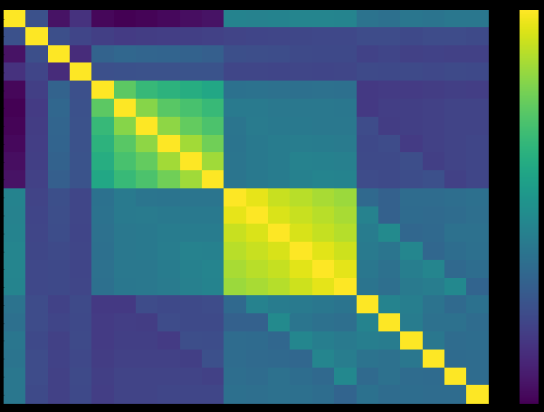
Feature Engineering & Selection
The Billing Terms & Payment Timeliness were strongly correlated
These were replaced by:
Principal components (☹)
Ratios (☹)
Aggregated Difference Paud Vs Billed (☹)
Limit Balance – Bill Amt + Pay Amt (😐)
Difference of Paid Vs Billed (☺)
K means Cluster of these Features (☺ )

Slide 8
ML Models Application
Logistic Regression
Recall Score was 0.0 on the initial run
Decision Tree
Hyper Parameter Tuning
AUCROC:0.696
Random Forest with Python
Hyper Parameter Tuning
ADABoost
Stacking
Hyper Parameter Tuning
Voting
Hyper Parameter Tuning
Hyper Parameter Tuning
We abandoned it
Max Acc : 0.759
AUCROC:0.707
Max Acc :0.784
AUCROC:0.705
Max Acc : 0.751
AUCROC:0.709
Max Acc : 0.754
AUCROC:0.709
Max Acc : 0.775

Slide 9
Model | Iteration | Accuracy Score |  | Recall Score | precision | Steps
Logistic Regression | 0 | 0.780 |  | 0.790 | 0.830 | No Change
 | 1 | 0.574 |  | 0.570 | 0.740 | Oversampling
 | 2 | 0.572 |  | 0.570 | 0.740 | Undersampling
 | 3 | 0.662 |  | 0.660 | 0.750 | Oversampling After Replacing other value
 | 4 | 0.648 |  | 0.650 | 0.750 | Undersampling after Replacing other values
 | 5 | 0.776 |  | 0.780 | 0.700 | Normalised Data
Decision Tree | 6 | 0.722 |  | 0.720 | 0.730 | Decision Tree with default parameters on Normalised Data
 | 7 | 0.724 |  | 0.720 | 0.730 | Decision Tree with default parameters on Original Data
 | 8 | 0.727 | 0 | 0.820 | 0.820 | Oversampling After Replacing other value Original Data
 |  |  | 1 | 0.410 | 0.400
 |  |  | Overall | 0.730 | 0.730
 | 9 | 0.617 | 0 | 0.620 | 0.850 | Undersampling After Replacing other value Original Data
 |  |  | 1 | 0.620 | 0.320
 |  |  | Overall | 0.620 | 0.730
 | 10 | 0.716 | 0 | 0.730 | 0.880 | Undersampling with max_depth=4,min_samples_split=200,min_samples_leaf=35,max_leaf_nodes=15 in Decision tree
 |  |  | 1 | 0.660 | 0.410
 |  |  | Overall | 0.720 | 0.780
 | 11 | 0.693 | 0 | 0.700 | 0.880 | Oversampling with max_depth=4,min_samples_split=200,min_samples_leaf=35,max_leaf_nodes=15 in Decision tree
 |  |  | 1 | 0.680 | 0.390
 |  |  | Overall | 0.690 | 0.780
Random Forest | 12 | 0.757 | 0 | 0.800 | 0.880 | Oversampling with n_estimators=5,max_depth=7,min_samples_split=10,min_samples_leaf=2 in Random Forest
 |  |  | 1 | 0.620 | 0.460
 |  |  | Overall | 0.760 | 0.790
 | 13 | 0.756 | 0 | 0.800 | 0.880 | Undersampling with n_estimators=5,max_depth=7,min_samples_split=10,min_samples_leaf=2 in Random Forest
 |  |  | 1 | 0.620 | 0.460
 |  |  | Overall | 0.760 | 0.790

Slide 10

Final Thoughts
We could have done more / better
Use more feature transformations
Use One Hot Encoding etc to encode Age or other categorical parameters
Could have used Pipe Lines and other techinques
Paid more attention in class when things were being taught (Not Applicable for All)

